Slide 1

Parallel Programing and Raspberry Pi
Sanju Byanjankar
Joshua Schulz
Connor Dickinson

Slide 2
Objective
Deploying a Website using a raspberry pi cluster
The website teaches C programming language
The website features parallel programing using distributed-memory application.
Example: W3Schools
Directions on how we do this will be saved to be reproduced by others

Slide 3
Roles
Dr. Xuguang Chen : Client
Sanju: Team Manager/ Network Engineer
Joshua: Web Development/Software Engineer
Connor: Web Development/Software Engineer

Slide 4
Raspberry Pi and Networking
3 Raspberry Pis are connected to each other via network switch.
Jumping from one raspberry Pi to another is made possible by using secure shell (ssh).
RSA keys are generated and exchanged on each raspberry pis to build a trust which allows us to ssh without authentication.
All 3 Raspberry pis are running a Node Web Server and has the file named demofile.html.
3 servers: Server1, Server2 and Server3 listens to the port 8000 for the HAProxy (High Availability Proxy) which is a load balancer and connects the traffic to the Server that has least connection.
Front end of HAProxy listens to port 80 from the end user

Slide 5
Raspberry Pi and Networking (Contd..)
MPICH (Message-Passing Interface Chameleon) is installed into the devices and is ready for parallel programming (machinefile).
Remote Desktop is installed so that the servers can be worked on from outside of the network.
Local Servers’ IP addresses:
Server1 : 192.168.0.200
Server2 : 192.168.0.201
Server3 : 192.168.0.202

Slide 6
Website Development
Create an easy to navigate website with lab exercises each week
Lessons are spread out over 13 weeks
Develop a plan for teaching
Divide courses to be worked on
Test each others work to ensure appropriate levels of teaching is valid
Languages used are HTML, CSS

Slide 7
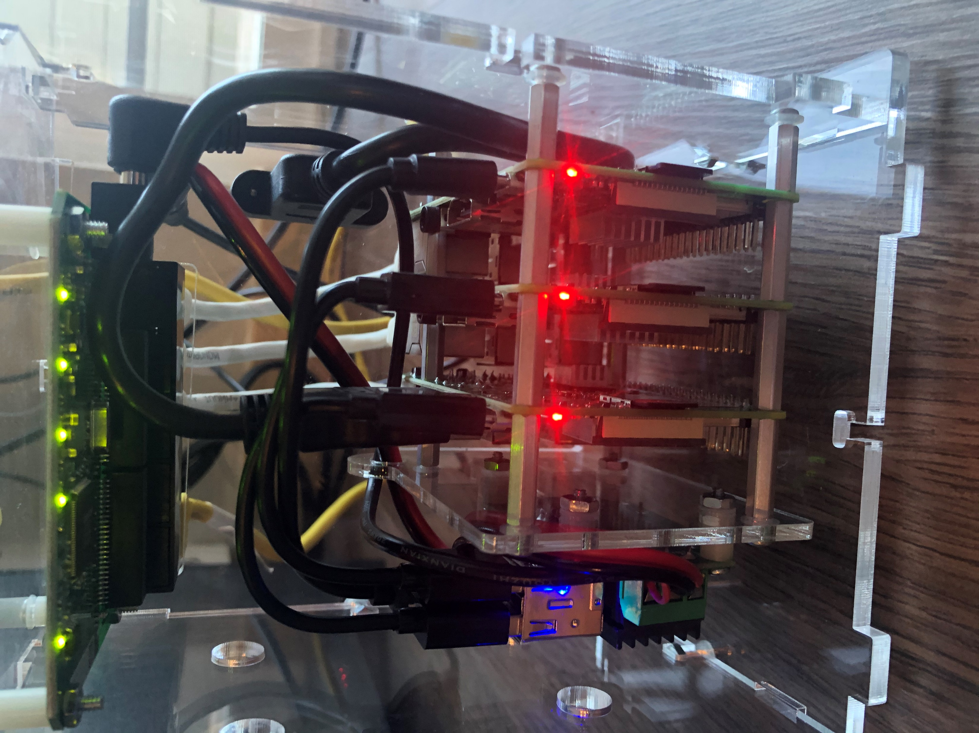
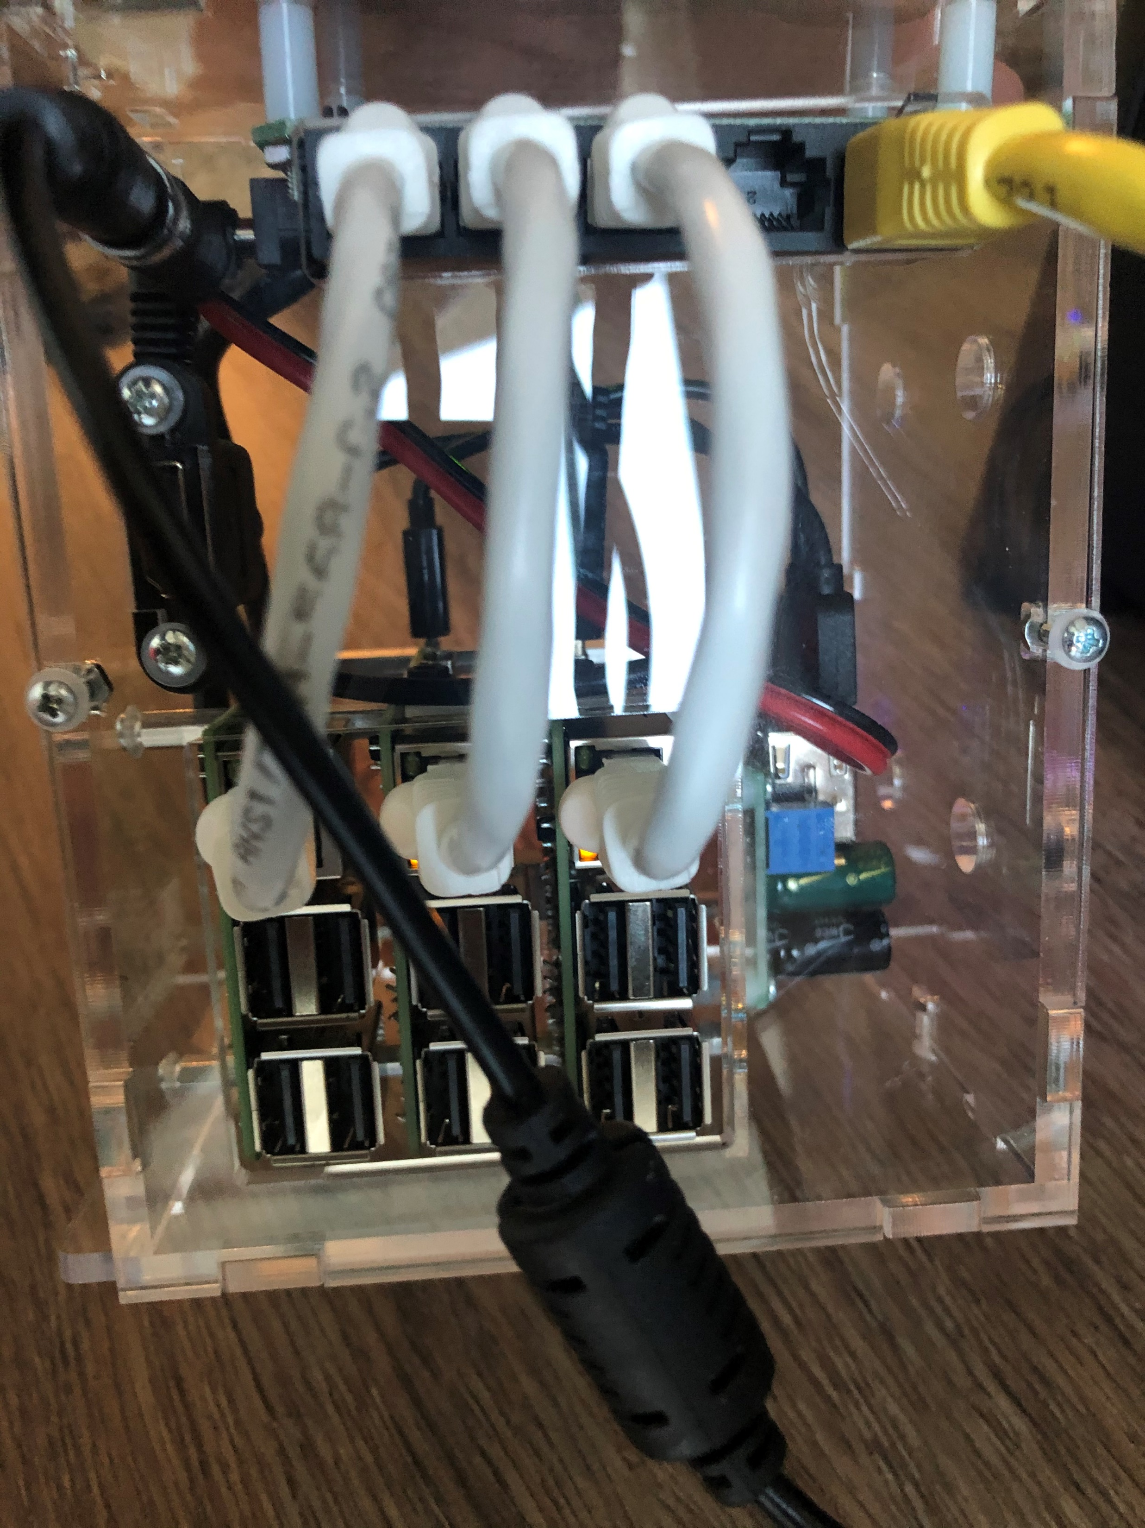
Raspberry Cluster Web Servers at work

Slide 8

End
Demo

